Slide 1

What Will A Clean Energy Future Look Like in 2050?
And How Do We Get There?
Pat and Steve Miller patmiller@comcast.net stevemiller@comcast.net http://climate.smiller.org http://electric.smiller.org
Your Town FOR
CLEAN ENERGY
Notes:
These slides and all resources are linked at the above URL

Slide 2



Sierra Club
100% Committed
Our mission is to leave a legacy of a livable world for our children and grandchildren.

Slide 3

Insert Greta video here
Notes:
Great Thunberg addresses the leaders of all countries at UN

Slide 4
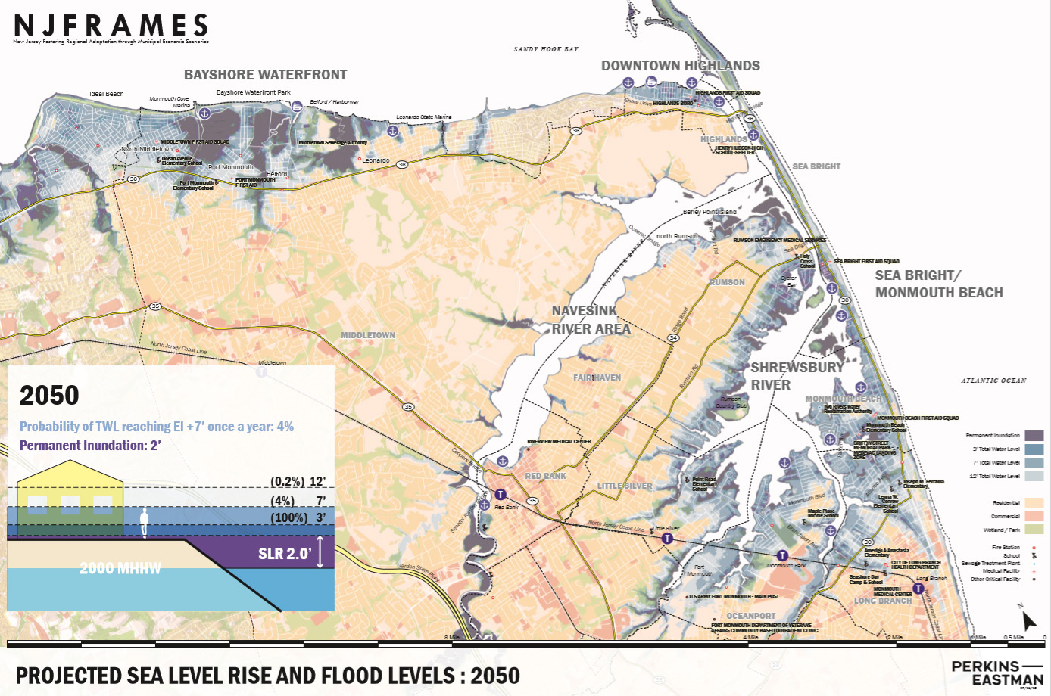
PROJECTED SEA LEVEL RISE-2050

Slide 5
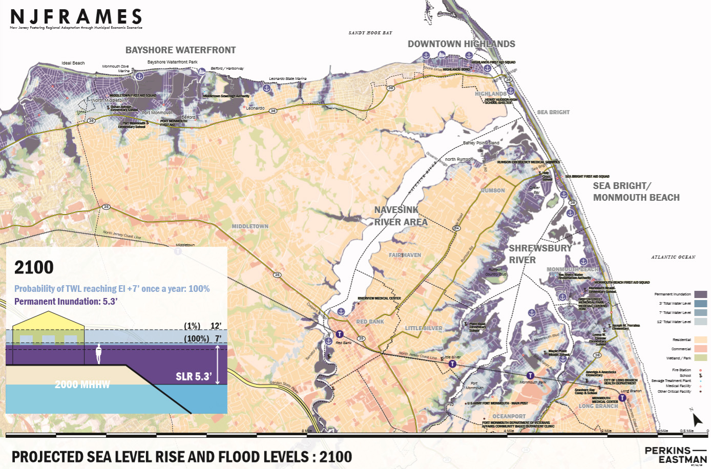
PROJECTED SEA LEVEL RISE-2100

Slide 6
HOW DO I KNOW WE WILL HAVE A CLEAN ENERGY FUTURE BY 2050?
Because We Must!
We must save the world for our children and grandchildren. Starting Now!
And We Will.

Slide 7
WHAT CRISIS?
1. UN IPCC: “The Impacts of Global Warming of 1.5°C”, Oct 2018
2. National Climate Assessment, Nov 2018
3. 2018 Arctic Report Card, NOAA, Dec 2018
4. Global Assessment Report on Biodiversity and Ecosystem Services, May 2019
5. IPCC (UN): “Ocean and Cryosphere in a Changing Climate”, Sept 25, 2019
Notes:
Oct 2018 IPCC: Scientists around the world. Concluded Paris Agreement limit of 2degreesC NOT sufficient to avert human catastrophe. Warming above 1.5degreesC will result in extreme storms, higher sea levels; droughts with crop failures and food shortages; fires; marine system collapse (species lost; food shortages
Nov, 2018 National Climate Assessment: 13 US gov agencies led by NOAA; 300 experts: disasters broken down by US region: NE: more rain/flooding; W: drought/fires $200B annual loss in US by 2050; US GDP contracts 10% by 2100
Dec 2018 Arctic Report Card: 80scientists/12 countries: surface temps breaking records & increasing 2X faster then rest of globe; . More sluggish/wavy jet-strea results: North pole heat waves; severe winter storms in E.US in 2018; extreme cold in Europe, March, 2018
9/25/2019 IPCC Ocean report more than 100 scientists from36 countries: oceans are getting hotter and accelerating higher. Up to 3.6 feet rise by 2100 (more in NJ, etc), and could be halved if emissions are cut. Flood damage expected to increase unless emissions are radically cut. By 2050, many of the 680 million people, living in low-lying coastal areas will experience one in 100 year storms at least once per year or more often.. Ocean are projected to transition to unprecedented conditions: increased temps; upper ocean stratification, acidification, oxygen decline, decrease in food production, esp in tropics. Changes will be smaller with low emissions. Rising sea levels at 2degreesC could displace 280 million people.
HIGH EMISSIONS SCENARIO: By 2100, sea levels rising 6 inches per decade
LOW EMISSIONS SCENARIO: By 2100, sea levels rise 1.5 inches per decade
THE CHOICES MADE NOW ARE CRITICAL TO LIMIT THE FUTURE IMPACTS, and avoid escalating costs and risks!

Slide 8
HOW DO I KNOW WE WILL HAVE A CLEAN ENERGY FUTURE BY 2050?
Because the people demand it.
Notes:
.

Slide 9
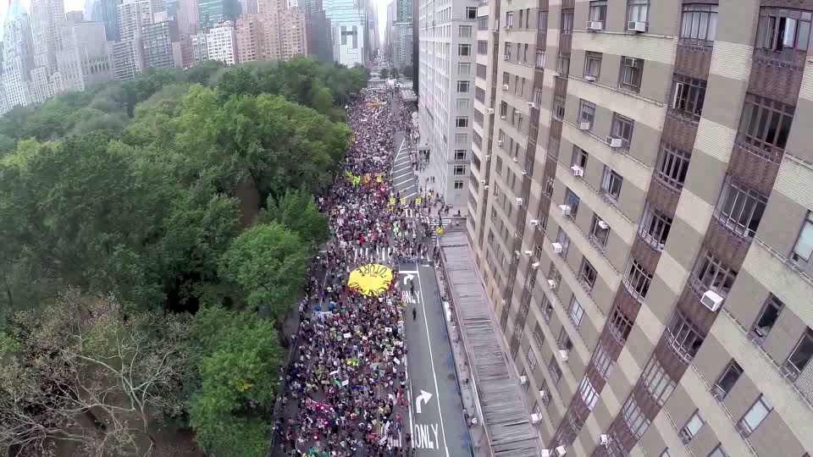
© 2014 People’s Climate March
Notes:
People demanded ACTION, at the People’s Climate March, NYC, before the Sept, 2014 UN Climate Meeting
One reason is: we’re seeing hundreds of thousands of people in these giant demonstrations, this one of the eve of the last UN summit on climate. And another one is coming up.
DESCRIPTION: Drone-shot video showing the extent of participants at the People’s Climate March in New York City, United States, September 21, 2014
ADDITIONAL TALKING POINTS: In September 2014, huge demonstrations all around the world pushed for international action on climate change. Attendees of the march in New York City included United Nations Secretary General Ban Ki-moon and former US Vice President Al Gore. New York City Mayor Bill de Blasio had recently committed the city to reducing greenhouse gas emissions 80 percent by 2050.[1*]
REFERENCES:
[1*] Lisa W. Foderaro, “Taking a Call for Climate Change to the Streets,” The New York Times, September 21, 2014. http://www.nytimes.com/2014/09/22/nyregion/new-york-city-climate-change-march.html

Slide 10
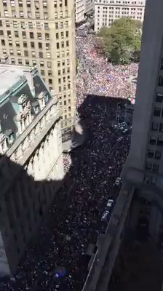
GLOBAL
YOUTH
CLIMATE
STRIKE
NYC
September 20, 2019
Notes:
And the Youth of the world demanded Climate Action during this Strike, Sept, 2019, by 250K people in NYC (8 million people, in thousands of events during the week before and during the 2019 UN Climate summit in this was the current UN Climate summit in NYC.
Pat and I were down there carrying Climate Crisis signs as we marched and chanted to Battery Park to hear Greta Thunberg, the climate hero of the world’s youth.

Slide 11
HOW DO I KNOW WE WILL HAVE A CLEAN ENERGY FUTURE BY 2050?
And the market will drive it.
Notes:
197 countries have signed or acceded to the Paris agreement. Subsequently, the Trump administration announced its intention to withdraw

Slide 12
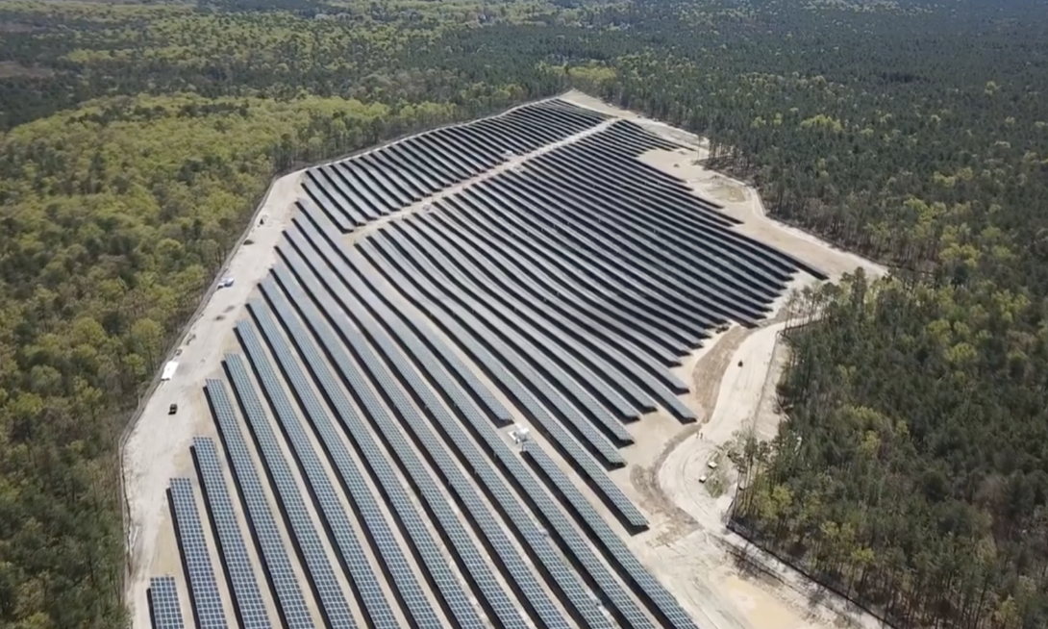
Solar at Six Flags Great Adventure
Notes:
Across NJ, we have companies like “KDC Solar”, who specialize in erecting immense solar fields, in partnership with large businesses. “KDC Solar” offers to erect solar systems, with no up-front cost, and then sell the electricity to the business at a BIG savings over JCP&L. This is called a “Purchase Power Agreement” or “PPA” – keep your eyes open- this is happening ALL OVER THE US.
It is very similar to a homeowner, renting their rooftop to a solar installer for $1. That installer then installs and owns the rooftop solar, and sells low cost electricity to the homeowner.

Slide 13
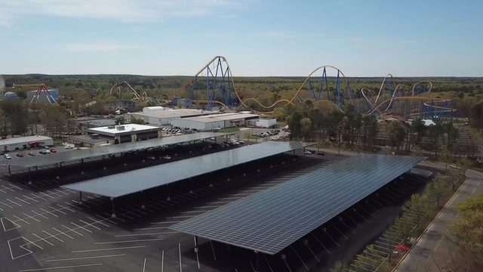
Six Flags Solar Canopy over Parking
Notes:
Similarly, Sea Brook Village in TintonFalls (15 acres of solar)
CentraState Hospital, Freehold (26 acres 6.3MW; 8.1 million KWH/Yr.)
In Middletown, we advocate for the Middletown train station parking to be covered with a solar Canopy, like the photo. The Middletown Administrator is using an energy consultant to look into pricing.

Slide 14
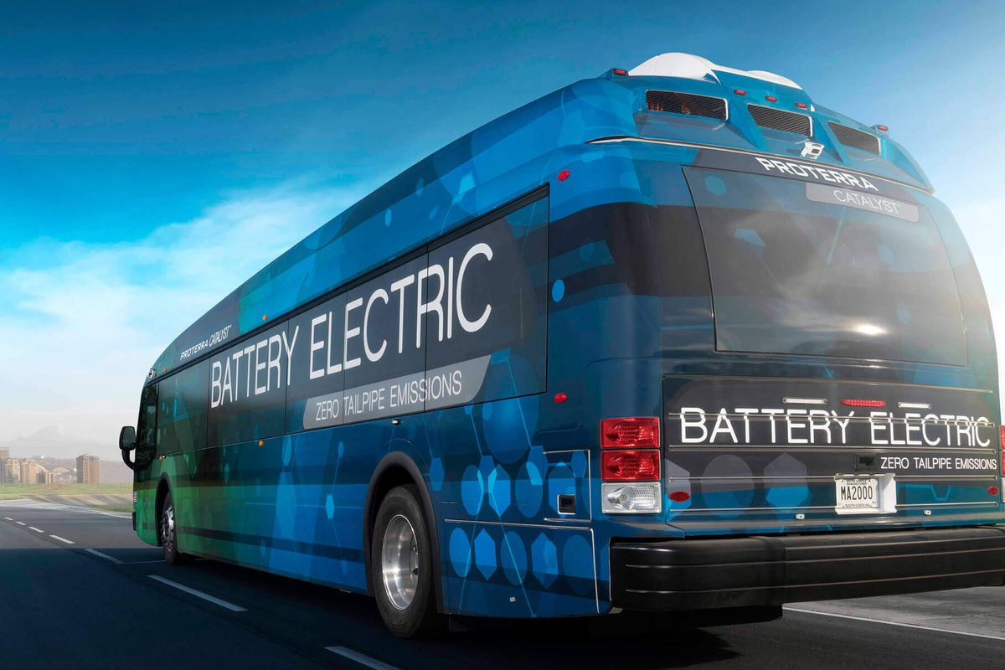
ELECTRIC BUS
Notes:
TRANSPORTATION IS THE LARGEST SOURCE OF GHG EMISSIONS
China is currently making ALL of its buses to be electric- and hopes to be the dominant world-wide electric bus supplier.

Slide 15

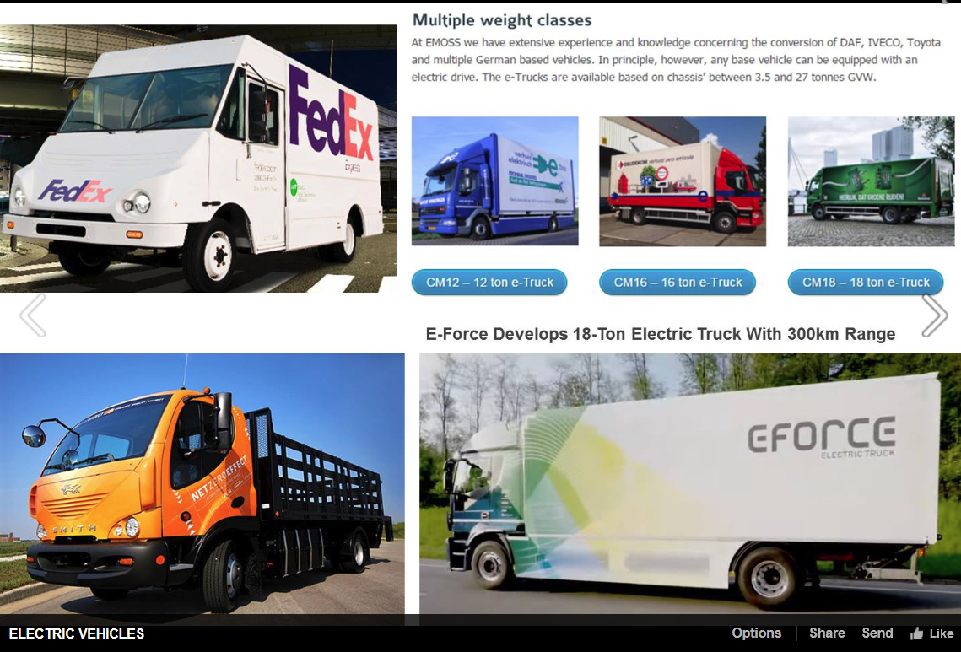
ELECTRIC TRUCKS
USE ARIAL BOLD FONT.
Tesla
Semi truck (9/2017)
Pickup truck (2018)
Volvo
Delivery &
Garbage trucks (5/16/2018)
Self-Driving Semi (9/14/2018)
https://www.ecowatch.com/anheuser-busch-electric-trucks-2640827841.html
Notes:
AND ECONOMICS DICTATES WE WILL HAVE ELECTRIC TRUCKs.
We are moving forward for economic reasons, and because above 2 degrees C rise, much of our world becomes unliveable for our children
CLICK
Anheuser-Busch just announced the purchase of 21 electric “Class 8” trucks to handle its California deliveries.
Building a 1MW solar filed to offset electricity required to charge these trucks
Pledged 25% carbon emission reductions across their entire value chain by 2025

Slide 16

AND ELECTRIC AIRPLANES
Notes:
Propeller driven planes are moving to batteries.
Jets are exploring renewable Bio-fuel for jets, and are currently testing with 1000s of flights:
*********
Conversion of municipal solid waste/garbage to biofuel
Conversion of “forest residues”
Conversion of carbon emissions to fuels

Slide 17

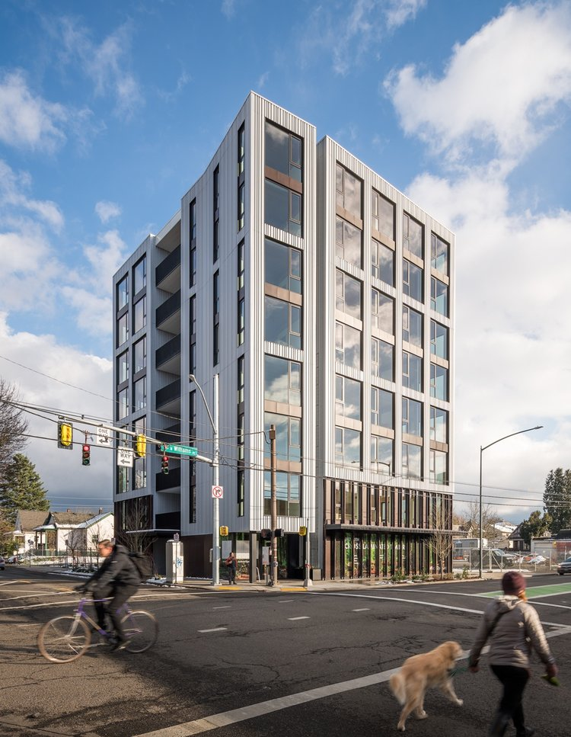
TALL BUILDINGS FROM WOOD
“T3” Timber, Technology, transit OFFICE, MINNEAPOLIS
Clad in weatherinG steel
“CARBON12” residential
PORTLAND, OR
Notes:
11% of global carbon emissions comes from Building materials
Architects around the world are starting to design tall buildings with wood, instead of traditional steel and concrete buildings which emit a LOT to manufacture
CLICK
These tall building are built with cross-laminated, glued and nailed timbers
Carbon Net zero construction is the norm for timber framed buildings!
And the carbon is sequestered in the building, and reused when the building is eventually replaced.
CLICK
University buildings seem over-represented
After all, universities TEACH sustainability principles!

Slide 18

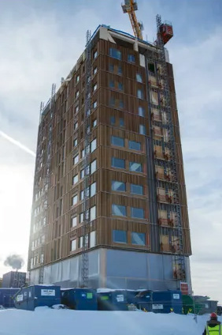
TALL BUILDINGS FROM WOOD
Rhode Island school of design, providence, DORM,
“Mjosa” world’s tallest tower
18 floors, Norway
hotel, homes, office
Notes:
Many studies, including Yale Univ & Univ of Wash have shown that Netzero construction is possible!
By managing the forest to harvest only what is grown
THE CARBON IS SEQUESTERED IN THE BUILDING and results in netzero construction emissions!

Slide 19
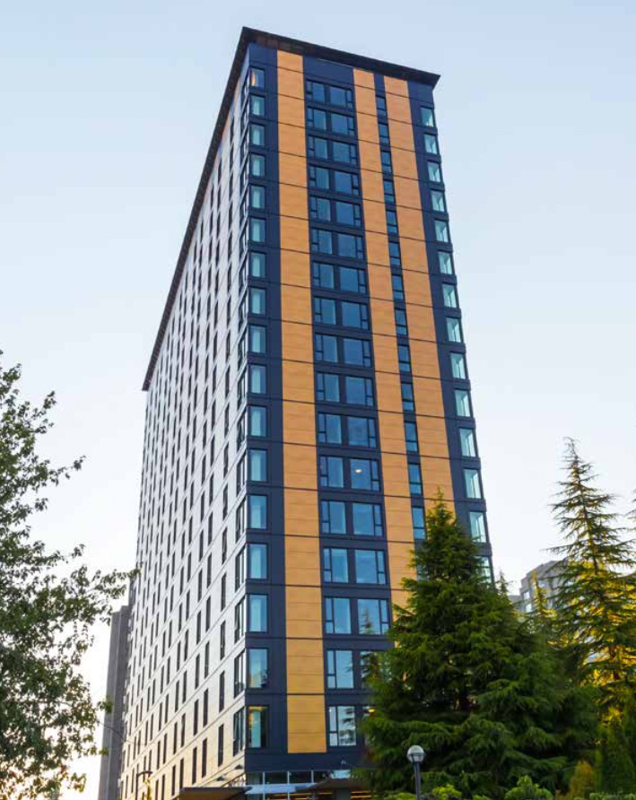
TALL BUILDINGS FROM WOOD
Brock commons
Univ of british Columbia
18 story dorm
Top floor lounge:
timbers are left uncovered
Stores 1,800 metric tons carbon
(when building is finally torn down, the wood can be reused)
Manage and Preserve forests
Use and reuse the timber!!
Notes:
It is not random that universities are over-represented.
More and more are known for sustainability.
Universities have sustainability managers,
And try to impress with sustainability practices/buildings

Slide 20
OTHER CHANGES WE WILL SEE IN 2050
Building standards to require net-zero emissions, net-zero waste, net-zero water, rooftop solar (where practical)
Heating and appliances all electric; no gas furnaces, hot water heaters, stoves, or dryers
Electric grid upgraded for reliability and smart metering
EV charging stations replace gas stations; or exchangeable batteries
Plastic and Styrofoam packaging, bags, straws – all gone
US breadbasket will grow only food, not ethanol, and far more plants than animals
Notes:
BY 2050:
Highly energy efficient NETZERO building standards will be the norm.
FOSSIL FUELS are almost totally abandoned.
The world’s electric grids are upgraded for the high electrical loads
GAS STATIONS ARE NON-EXISTENT.
In Maryland, the 1st First US gas station just dumped the pumps & installed EV Chargers
Our plastic mess is gone
We are moving to a plant-based healthy diet.
We MUST make these changes to save lives.
If we wait, the solutions become ever more costly

Slide 21
New Jersey’s Clean Energy Initiatives
100% Clean Energy by 2050
Rejoin Regional Greenhouse Gas Initiative (RGGI)
Join US Climate Alliance
Renewable Energy Law
  Renewable Energy Standard (graduated to 50% by 2030)
  Solar, Offshore Wind, Energy Efficiency, Energy Storage
  Community Solar, Energy Aggregation
NJ 2019 Energy Master Plan released in draft
Notes:
Gov Murphy Executive Order #28 on 5/23/2018: 50% renewable electricity by 2030 and 100% Clean Energy by 2050 –
rollout is being nailed down by 2019 Energy Master Plan, to be final by end of year.
We will have 3500 MW of Offshore Wind, new solar programs, Energy Storage AND
CLICK
RGGI provides carbon trading across east cost states. NJ is officially back in RGGI as of Jun 2019 and stands to benefit financially from credits that could be used for additional renewable projects.
BAN OFFSHORE DRILLING : we cant actually control drilling in Federal Waters (beyond 3 miles or so). BUT WE CAN and ARE PROHIBITING any use of land-based facilities – no ships, pipelines, etc.
12/18/2018 NJ joined with 9 other regional and mid-atlantic states in the “Transportation and Climate Initiative” (TCI) to within 1 year, define a low-carbon transportation policy

Slide 22
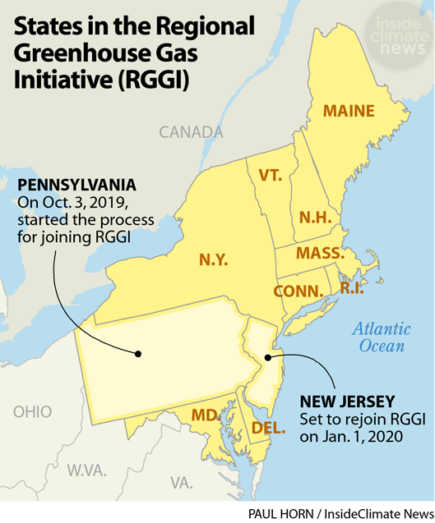
NJ to Join RGGI 1/1/2020
RGGI Results To Date:
-Carbon Emissions down 46%
-Electricity prices down 5.7%
(US rates up 7.6%)
-State economies grew faster than all other US states
-$3.2B revenue from carbon permit auction system
https://insideclimatenews.org/news/03102019/pennsylvania-rggi-coal-gas-power-plant-emissions-carbon-cap-trade-regulation
Notes:
NJ rejoins RGGI on 1/1/2020, to reap the beneifts:
READ
https://insideclimatenews.org/news/03102019/pennsylvania-rggi-coal-gas-power-plant-emissions-carbon-cap-trade-regulation
PA is a big deal: the nation’s #2 nat gas producer; #3 coal producer
PA gov says “we need to get serious” about the climate crisis:
"If we want a Pennsylvania that is habitable for our children and grandchildren, where temperatures aren't in the 90s in October ... where flooding doesn't destroy homes and businesses over and over again, we need to get serious right now about addressing the climate crisis," Gov Wolf said
The Gov of VA, a Dem, tried to join RGGI, but was blocked earlier this year by the state’s Republican-controlled legislature

Slide 23
What Am I To Do?
Switch To Clean Electricity
Install rooftop solar
Switch to a 100% clean supplier
Invest in or subscribe to community solar
Ask your town to supply renewable community choice electrical aggregation
http://electric.smiller.org
Notes:
You can switch to 100% clean electricity, AND save money, instead of defaulting to 20% clean electric from JCP&L.
Best investment: If you can SOON, pay cash to install rooftop solar.
OR (same GHG reduction): swtich to 100% clean supplier (spend 10 minutes, selecting vendor at URL)
OR – wait a couple of years for investors to build large array “Community Solar” fields – which should prove to be a GREAT investment for you
CLICK

Slide 24

Influence Your Town To Adopt Clean Energy
FLORIDA
Notes:
AND/OR – JOIN WITH OTHERS and push for your town to switch ALL residents to 100% renewable Community Choice Electric aggregation. This saves 5 or 10% on electric bill, and has the BIGGEST GHG reduction!

Slide 25
Influence Brookdale to Install Solar Panels
Explore the opportunity to install solar panels on unused field; parking lot solar canopies; and building rooftops
STEPS
        SIZE THE OPPORTUNTY: Brookdale solar potential (to be verified): 3.75MW solar, with 6GWh/year generation, which eliminates 4700 tons carbon annual emissions and could power 600 houses. If annual solar electricity exceeds Brookdale’s annual electrical usage, the extra solar could be sold as “Community Solar”
        EXPLORE (1) ground-mount solar at Mercer County Community College, and (2) large solar system powering CentraState Hospital (installations financed, designed and installed by KDC Solar)
        EXPLORE PPA (Power Purchase Agreement) options with a large industrial solar provider (KDC Solar, …). Zero up-front cost, and reduced Brookdale electric bills.
Notes:
GREAT OPPORTUNITY AT BROOKDALE CC: Push Brookdale Administration (& Monmouth County Freeholders) to install solar!
You have fields, parking lots, mucho building rooftops. That could eliminate 5 megatons/year of world-heating greenhouse gas, and SAVE the Freeholders money!
I listed your next steps- contact me for advice if you wish to explore!
10/6/l2019 data from Bob Erickson: Brookdale Community College: Est. 150K SQFT unused field + 763K parking (ignoring lanes) + 267K roof = ~1118K SQFT possible for solar panels. At assumed 25% area use, up to ~ 15K+ panels may be possible (perhaps ~$2.8M panel cost w/o installation). At 250 watt per panel this is ~ 3750 KW. Newark factor 4.4 sunlight hours per day ~ 16500 KWH per day, or ~ 6,000,000 KWH per year (non heating electrical for ~600 homes per year).
Carbon emission reductions estimated from KDC solar data for CentraState hospital, Freehold: https://kdcsolar.com/project/centrastate-medical-center

Slide 26
Switch To Plug-in Electric Vehicle (EV)
Plug Into Your Clean Electricity
Save On Fuel Costs (~30-70% more efficient)
Save On Car Maintenance
Notes:
MAKE YOUR NEXT CAR A PLUG-IN EV!
Save money, and stop the world from continued heating that will severely degrade your own, and descendants’ quality of life

Slide 27
More Personal Steps to Cleaner Energy
  Cut energy use: make home more efficient
  - Sign up for $49 energy audit https://www.savegreenproject.com/
    Insulate and air seal; install Smart thermostat
    Switch to LED lighting
  Make your next water heater electric tankless or heat pump
  Replace gas appliances (stove/dryer) with electric
  Make your next AC/furnace an electric geothermal sink heat pump
  Avoid single-use plastic (water bottles, straws, bags, take-out containers)
  Adopt a more plant-rich diet
Notes:
HIGHLY RECOMMEND: Get your parents to signup at savegreenproject.com for a $49 energy audit (a 2 hour, no obligation safety and energy assessment by an expert; THEN FOLLOW-THRU on recommendations
Insulate, seal, switch to LED bulbs
Switch your house electricity to 100% renewable. Then recharge your battery-powered car with that renewable household electric
Over next 2 decades: Switch from gas to electric
AND A BIGGIE: switch to a plant-rich diet – “DRAWDOWN” estimates that if, by 2050, HALF the worlds population switched to plant-rich, less than 2500 calories/day, the energy savings is MORE THAN all the world’s solar investment combined!!!

Slide 28
Sierra Club
100% Committed
Our mission is to leave a legacy of a livable world for our children and grandchildren.
Notes:
Join our mission to save the world! Help leave a legacy of a livable world for your children and grandchildren and beyond!!

Slide 29
Middletown for Clean Energy
Goals
Vision/Mission: 100% Clean Energy by 2050; (Electric by 2030)
Near-Term Benefits
  Clean Energy Businesses and Jobs
  Prestige as Leader in NJ; Enhanced Quality of Life
  Improved Air Quality and Health
  Gold Star in Energy
Strategy: Sustainable Jersey Gold Star in Energy
Actions: Efficiency, EV, Solar, Green Building in Master Plan
Notes:
This is what we are doing in Middletown. We encourage you to follow suit in YOUR town.
We want Middletown, all residents, and all businesses to use 100% clean energy by 2050, and 100% clean EVERYTHING by 2050.
Benefits: new jobs, enhanced quality of life, better health, and Get points and a “Gold Star in Energy” from Sustainable Jersey (the Green Team program, used in most towns in NJ)

Slide 30
Middletown for Clean Energy
Energy Plan
Middletown, with MCE Stakeholder Team, will create an Energy Plan, AKA Climate Action Plan.
Based on NJ 2019 Energy Master Plan
Guide residents in “visioning” through Community Outreach sessions.
Energy Plan will be linked to Middletown 2020 Master Plan
Please Join Us! - Sign up tonight!
Notes:
We are working, with the Middletown Sustainability Manager, to create an ENERGY PLAN, based on the forthcoming NJ Energy Master Plan, that will be a companion to the 2020 revision of the Middletown Energy Plan
Several other cities in Monmouth County are also revising there for the future.
Tonight is the prototype to guide all residents in a visioning the future of our towns.
Please sign up on our email list- to either our Middletown Stakeholder team, or simply to keep informed thru our email list.

Slide 31
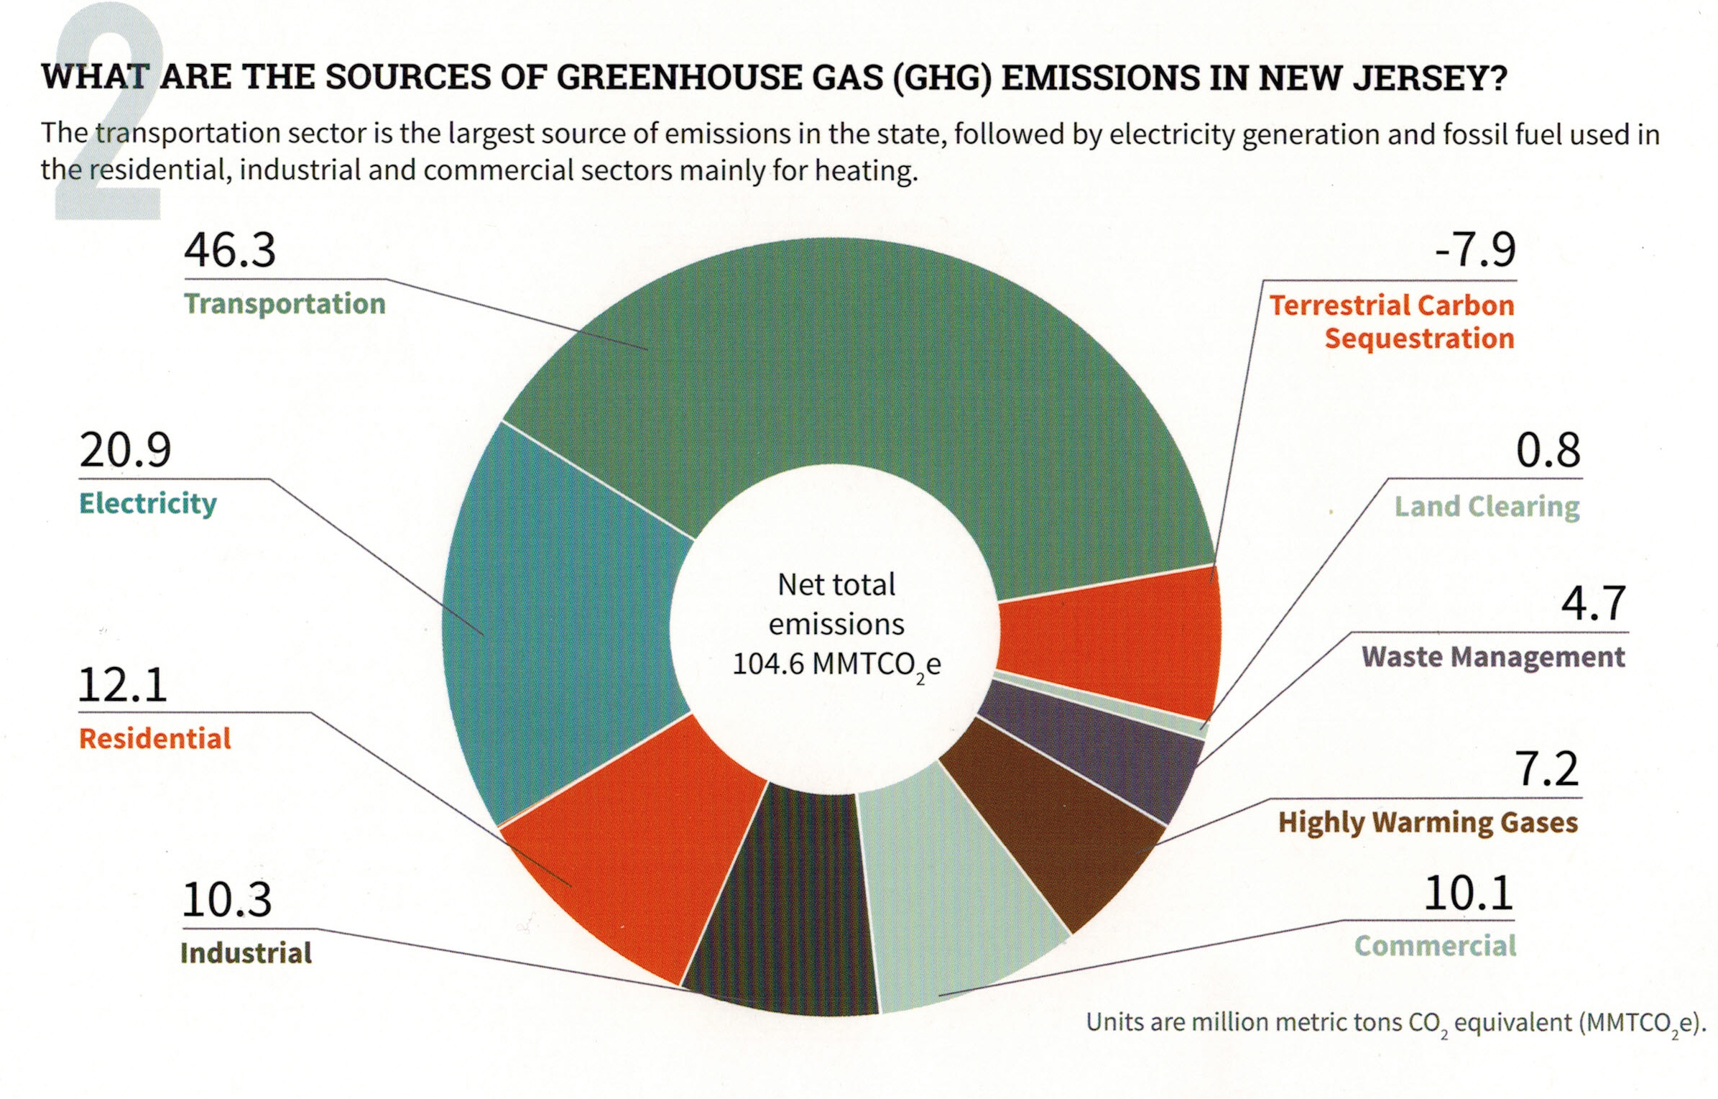
Your (Typical NJ) GHG Emissions EEEmissions
“Reducing NJ Greenhouse Gas Emissions”, Rutgers, Jan 2018
Notes:
This is the NJ “Footprint” of sources of world-heating Greenhouse gases, to show what to tackle first.
Sustainable Jersey states: “the primary goal [of “Gold Star in Energy” is reducing Green House Gases. Responding to this overarching imperative will help achieve all the other [sustainability] goals.”
20% of the GHG is from electricity generation; nearly 50% is from transportation.
Switching electricity to 100% wind/solar, then switching all vehicles to batteries charged by renewable electricity will ELIMINATE almost 70% of our GHG.
VERY IMPORTANT: -8% carbon sequestration by marshes, mudflats, trees, landscaping

Slide 32
NJ Energy Master Plan (EMP) Strategies
Transportation
Renewable & Distributed Energy
Efficiency & Conservation
Buildings
Environmental Justice Communities
Notes:
TONIGHT’s visioning focuses on these 5 strategies, found in the NJ 2019 Energy Master Plan.
We need YOUR visioning of what do you expect in an energy plan to enhance YOUR quality of life??
Following are examples of the 5 (These are also printed in front, above the white poster boards)

Slide 33
NJ EMP Strategies for Towns
More Detail
Transportation:
  Conservation (public transp., ride sharing)
  Transition municipal fleet to EV
  Charging stations in business & multi-fam housing
Renewable & Distributed Energy:
  Rooftop & community solar
  Onshore wind where possible
Notes:
TRANSPORTATION is the biggest source of GHG.
-Encourage use of public transportation or ride sharing
- Move the municipal trucks and cars to Evs
- distribute public charging stations, to encourage all residents to buy Evs
We need NJ sources of wind/solar: rooftop, community solar, or potentially VERTICAL wind turbines (rotating cylinder at top of a pole)

Slide 34
NJ EMP Strategies for Towns
More Detail, Cont.
Efficiency & Conservation:
  Make existing buildings efficient: insulation, seal air leaks, upgrade appliances
  Landscaping: tree ordinance, landscaping to reduce heat, conserve water, or provide food
Notes:
We already learned about imperatives of energy conservation of houses and businesses
ALSO, landscaping and trees provide carbon sequestration- VERY important

Slide 35
NJ EMP Strategies for Towns
More Detail, Cont.
Buildings (new and renovated):
  Net-zero carbon buildings – rooftop solar, siting for solar, all-electric (not fossil fuel) heat & appliances
  EV-ready
Environmental Justice Communities: seek local benefit of clean energy transition
  Local clean power generation
  Local workforce jobs and training
  Local EV public transport & EV charging
Notes:
We talked about net-zero (and “passive” house) construction – that are pre-wired for EV –chargers- esp chargers at multi-family structures.
Enivronmental Justice Communities all around NJ have been unduly affected by air and water pollution, and flooding!
We want to relieve the burdens so they don’t bare the cost of cleanups, and want them to share in the benefits of our clean energy future!

Slide 36
2 More NJ EMP Strategies
Modernize the Grid & Utility Infrastructure: smart metering, batteries, bi-directional grid flow
Clean Energy Innovation Economy: grow world-class research, create jobs, workforce training
These 2 strategies are part of the state plan but may not directly apply to towns.
Notes:
Finallly, we encourage NJ to MODERNIZE the electrical grid, and to create job training, like here in Brookdale, for future jobs in wind and solar, and energy efficiency opportunities.

Slide 37
What Will A Clean Energy Future Look Like in 2050?
And How Do We Get There?
QUESTIONS?
Pat and Steve Miller patmiller@comcast.net stevemiller@comcast.net http://climate.smiller.org http://electric.smiller.org
Your Town FOR
CLEAN ENERGY
Notes:
These slides and all resources are linked at the above URL

Slide 38
Visioning for 2050
What is Your Vision for a Clean Energy Future?
To realize your vision, what do you expect your community to supply or do?
Notes:
Edit to introduce Energy Plan.

Slide 39
Visioning for 2050
1. What is Your Vision for a Clean Energy Future?
(15 minutes)
FORM GROUPS of 4 or 5 people.
Select scribe (writes all input on 8x11 papers)
Brainstorm, list each idea (5 minutes). You may refer to examples in front of room.
Select top 2 from list (2 minutes)
Scribe has 1 min to verbally describe top 2
Scribe turns in the complete list
Notes:
Edit to introduce Energy Plan.

Slide 40
Visioning for 2050
EACH PERSON takes 6 post-its (corresponding to 6 categories)
2. To realize your vision, what do you expect your town to supply or do?
(10 minutes)
Write 1-2 expectations on ONE post-it for EACH category - Use both front & back of Post-it, if reqd
Place Post-its on corresponding poster
Notes:
Edit to introduce Energy Plan.

Slide 41
Visioning for 2050
Thank you for participating.
Check on 10/17/2019 for
  Slides (those not copyrighted)
  Results of your visioning
  http://climate.smiller.org
Middletown residents: JOIN “Middletown for Clean Energy”. Signup page is in front, and also on-line at above site
Notes:
Edit to introduce Energy Plan.

Slide 42
Visioning Categories
Transportation
Renewable & Distributed Energy
Efficiency & Conservation
Buildings
Environmental Justice Communities
Other
Notes:
Edit to introduce Energy Plan.

Slide 43
NJ EMP Strategies for Towns
More Detail
Transportation:
  Conservation (public transp., ride sharing)
  Transition municipal fleet to EV
  Charging stations in business & multi-fam housing
Renewable & Distributed Energy:
  Rooftop & community solar
  Onshore wind where possible
Notes:
Edit to introduce Energy Plan.

Slide 44
NJ EMP Strategies for Towns
More Detail, Cont.
Efficiency & Conservation:
  Make existing buildings efficient: insulation, seal air leaks, upgrade appliances
  Landscaping: tree ordinance, landscaping to reduce heat, conserve water, or provide food
Notes:
Edit to introduce Energy Plan.

Slide 45
NJ EMP Strategies for Towns
More Detail, Cont.
Buildings (new and renovated):
  Net-zero carbon buildings – rooftop solar, siting for solar, all-electric (not fossil fuel) heat & appliances
  EV-ready
Environmental Justice Communities: seek local benefit of clean energy transition
  Local clean power generation
  Local workforce jobs and training
  Local EV public transport & EV charging
Notes:
Edit to introduce Energy Plan.

Slide 46
2 More NJ EMP Strategies
Modernize the Grid & Utility Infrastructure: smart metering, batteries, bi-directional grid flow
Clean Energy Innovation Economy: grow world-class research, create jobs, workforce training
These 2 strategies are part of the state plan but may not directly apply to towns.
Notes:
Edit to introduce Energy Plan.

